Slide 1


Quality Management System
Presenter : P Jathin & Y Pavan Kumar
Team TechFLUENT
Date: 22th June 2026

Slide 2


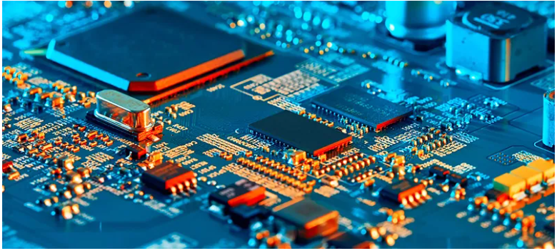
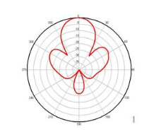
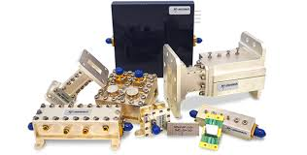


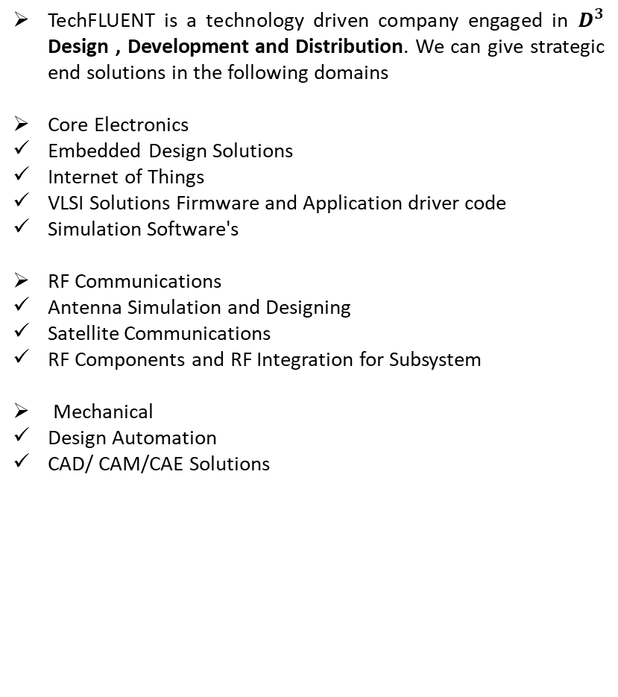
About TechFLUENT
TechFLUENT is a technology driven company engaged in $D^{3}$ Design , Development and Distribution. We can give strategic end solutions in the following domains
Core Electronics
Embedded Design Solutions
Internet of Things
VLSI Solutions Firmware and Application driver code
Simulation Software's
RF Communications
Antenna Simulation and Designing
Satellite Communications
RF Components and RF Integration for Subsystem
Mechanical
Design Automation
CAD/ CAM/CAE Solutions

Slide 3
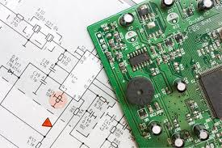

TechFLUENT Business Verticals - I
Design Solutions
Engineering Solutions
TechFLUENT Design team has been developing products and extending services to the clients in the areas of Core Electronics, Wireless, Process Instrumentation and RF.
TechFLUENT with its design in-house team has developed various products, to name few among them are Data Loggers, Tide Guage Formatters, Outdoor Terminals, Embedded Base board, Embedded Advanced Board and RF based Boards etc
TechFLUENT Engineering Services team formed strategic alliances with multi-faceted collaborative partners to leverage our cumulative strengths, resources and technologies to bring next generation solutions to our clients.
Our solutions are packaged to meet the stringent requirements of DRDO Labs, Aero Space, PSU’s, SME’s and Academicians.

Slide 4

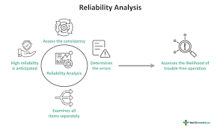

TechFLUENT Business Verticals-II
Man Power Services
Reliability Services
Trainings
TechFLUENT Team also offers and offloads the activities by providing the out sourcing support to Defence sectors, PSU’s and Industries with expertise as per the requirement from the customer Scope of work.
TechFLUENT Services team also offers the Reliability analysis to the defence sector at the Entire integrated system level and individual System level as well.
TechFLUENT Engineering Team offers the strategic training courses to bridge the gap between the academicians and industry standard Requirements by offering the training on rea time embedded , Graphical system Design, FPGA Driver development, VHDL Programming , PCB and RF Simulation

Slide 5
Introduction to Quality Management System Solution
A Quality management system uses the structured framework of policies, Processes and Procedures used to ensure that an organization Equipments & LRU’s Constantly meet the functionalities , While constantly improving the performance.
TechFLUENT Quality Management System Comprises of the Customized, Indigenous and Scalable User interface software with better user accessibility, Security, Customizable & Dynamic Dash boards and Menu options. This Software ensures the quality management process for testing the quality of Equipment's & LRU’s along with all the required artifacts extraction in each phase of the inspection.
Objectives:
QMS Ensures consistent quality of Equipments & LRUs along with products and services
Increase customer satisfaction
Improve organizational efficiency
Support compliance with laws and Standards
Promote Continuous improvement in all the processes

Slide 6
Features of Solution
User management and Role management
Type of Users
Admin
Initiator
Request Approver
QA Head
OA Inspector
ORDAQA Head
ORDAQA Inspector
Team Head QA
Dynamic menu based on User Role
Access control based on User Role
Inspection Request
Create Inspection Request (Initiator|Admin)
Quality Checks
Assign Request to Inspector
Define Inspection Check list
Update Inspection check list status (Edit & view Details)
Create quality checks – Final check
Attach inspection evidences
Close the Inspection
Approval or Reject the Inspection Report

Slide 7
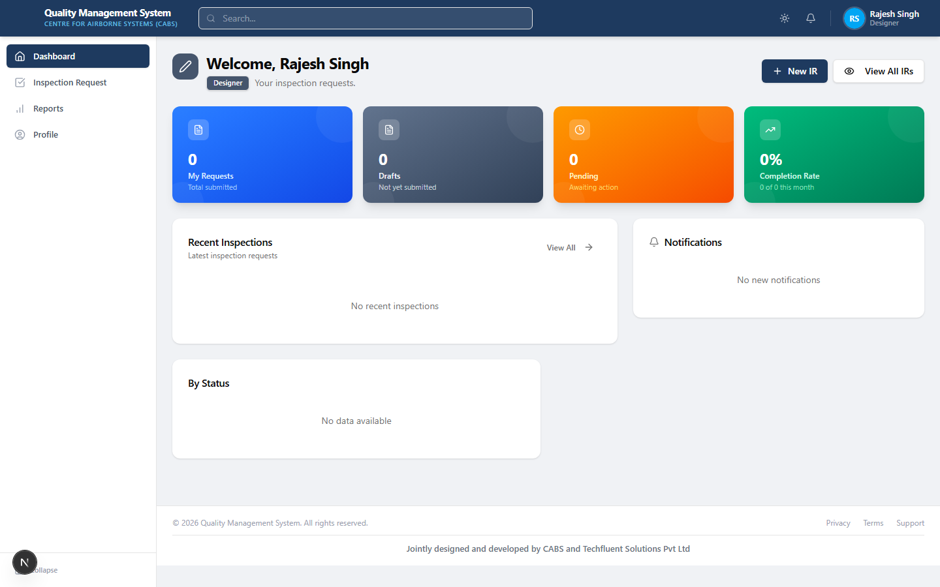
Dashboard

Slide 8
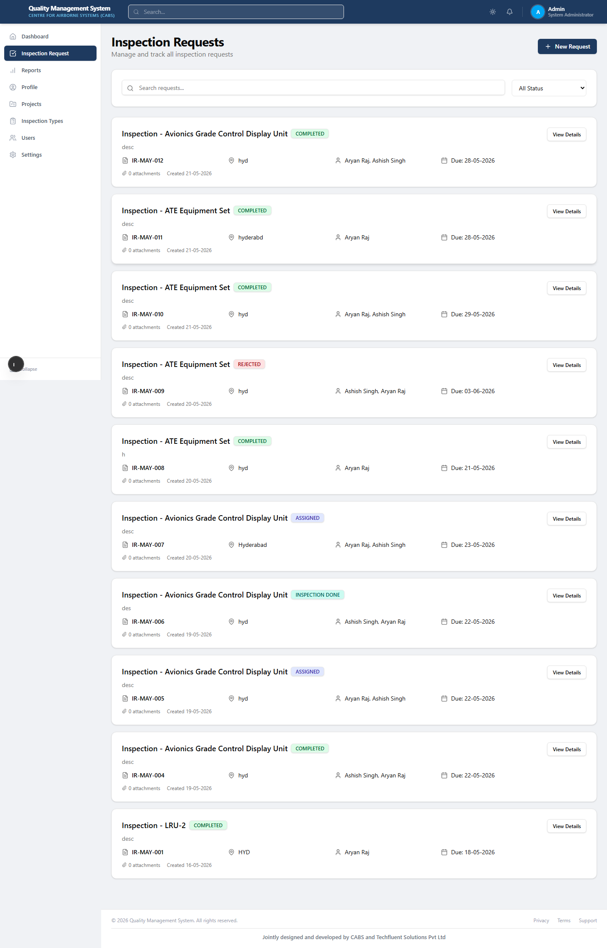
Inspection Request List

Slide 9
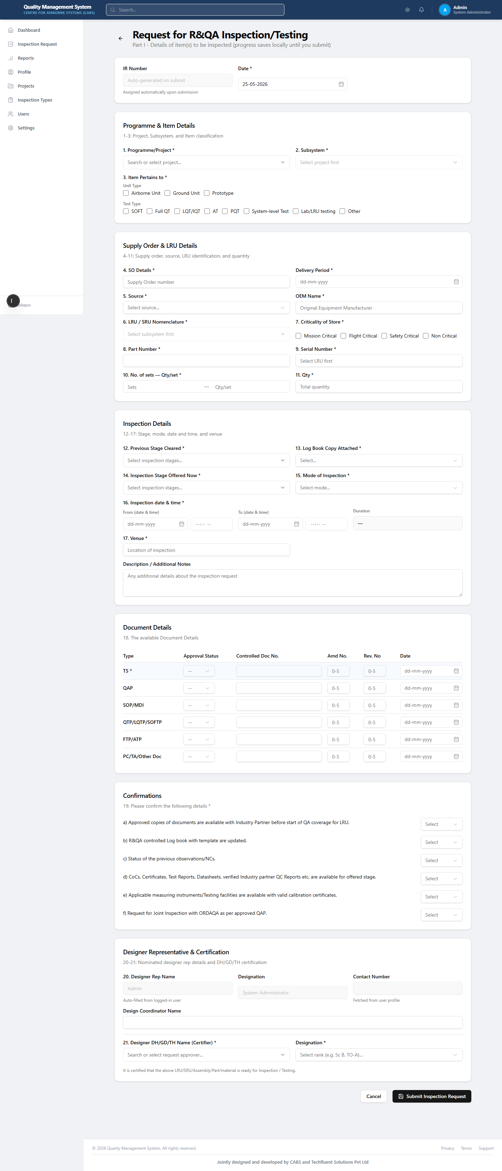
Create New Inspection Request (Part I)

Slide 10
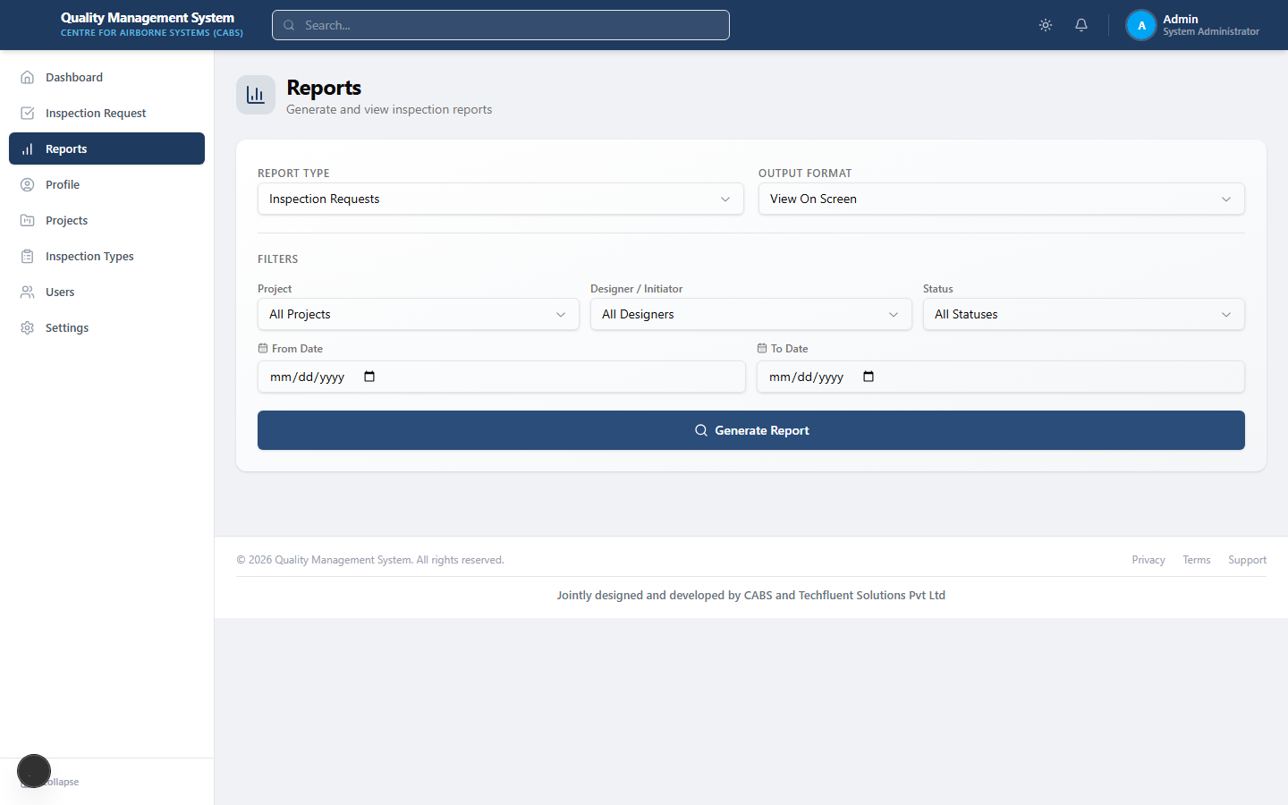
Reports
View of complete Inspection Report for all the users

Slide 11
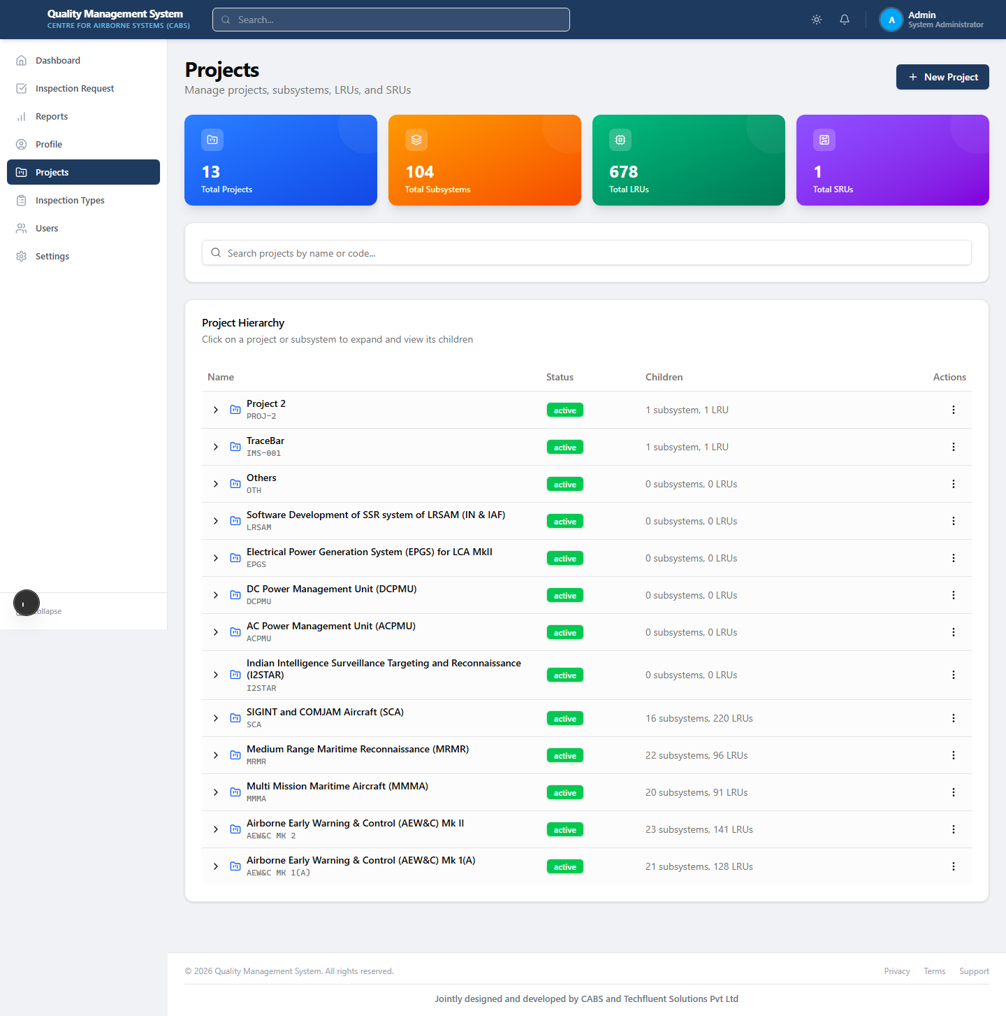
Projects, Subsystems, LRUs & SRUs

Slide 12
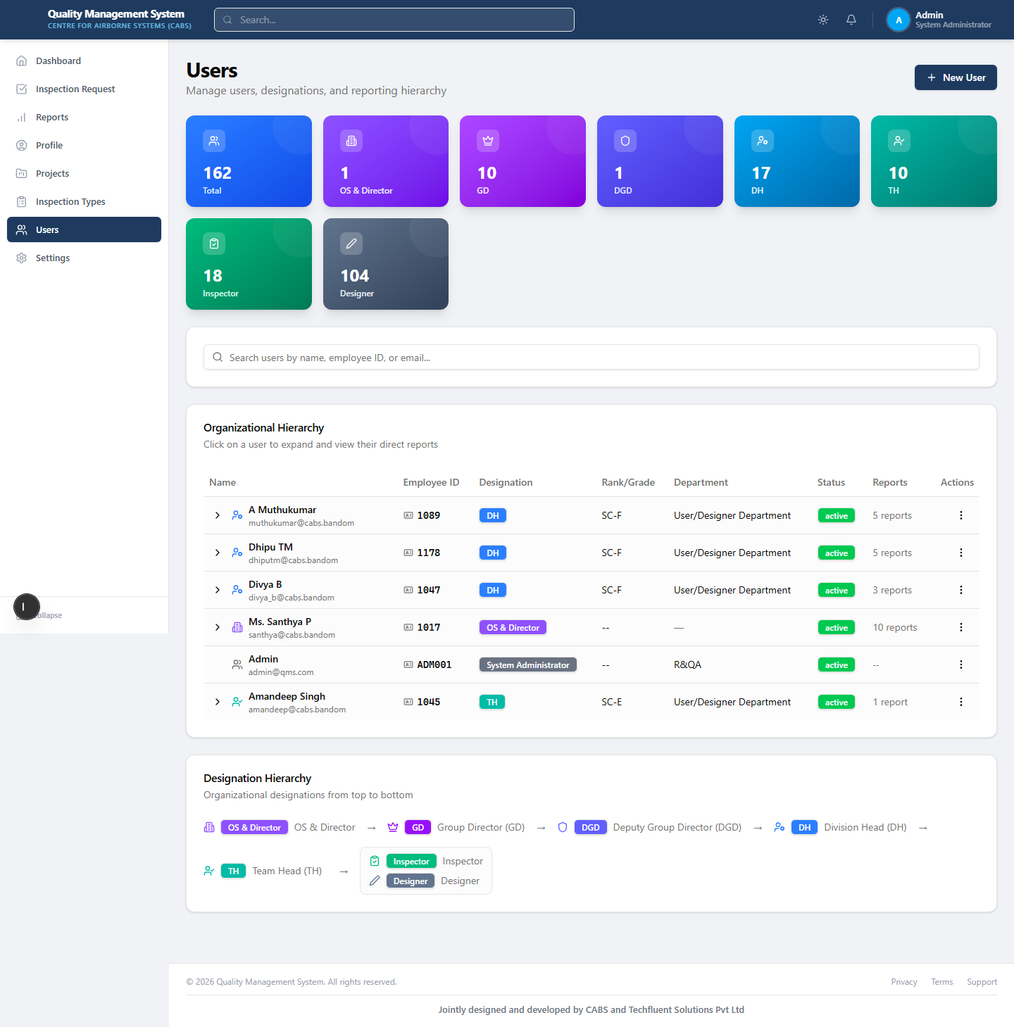
User Management

Slide 13
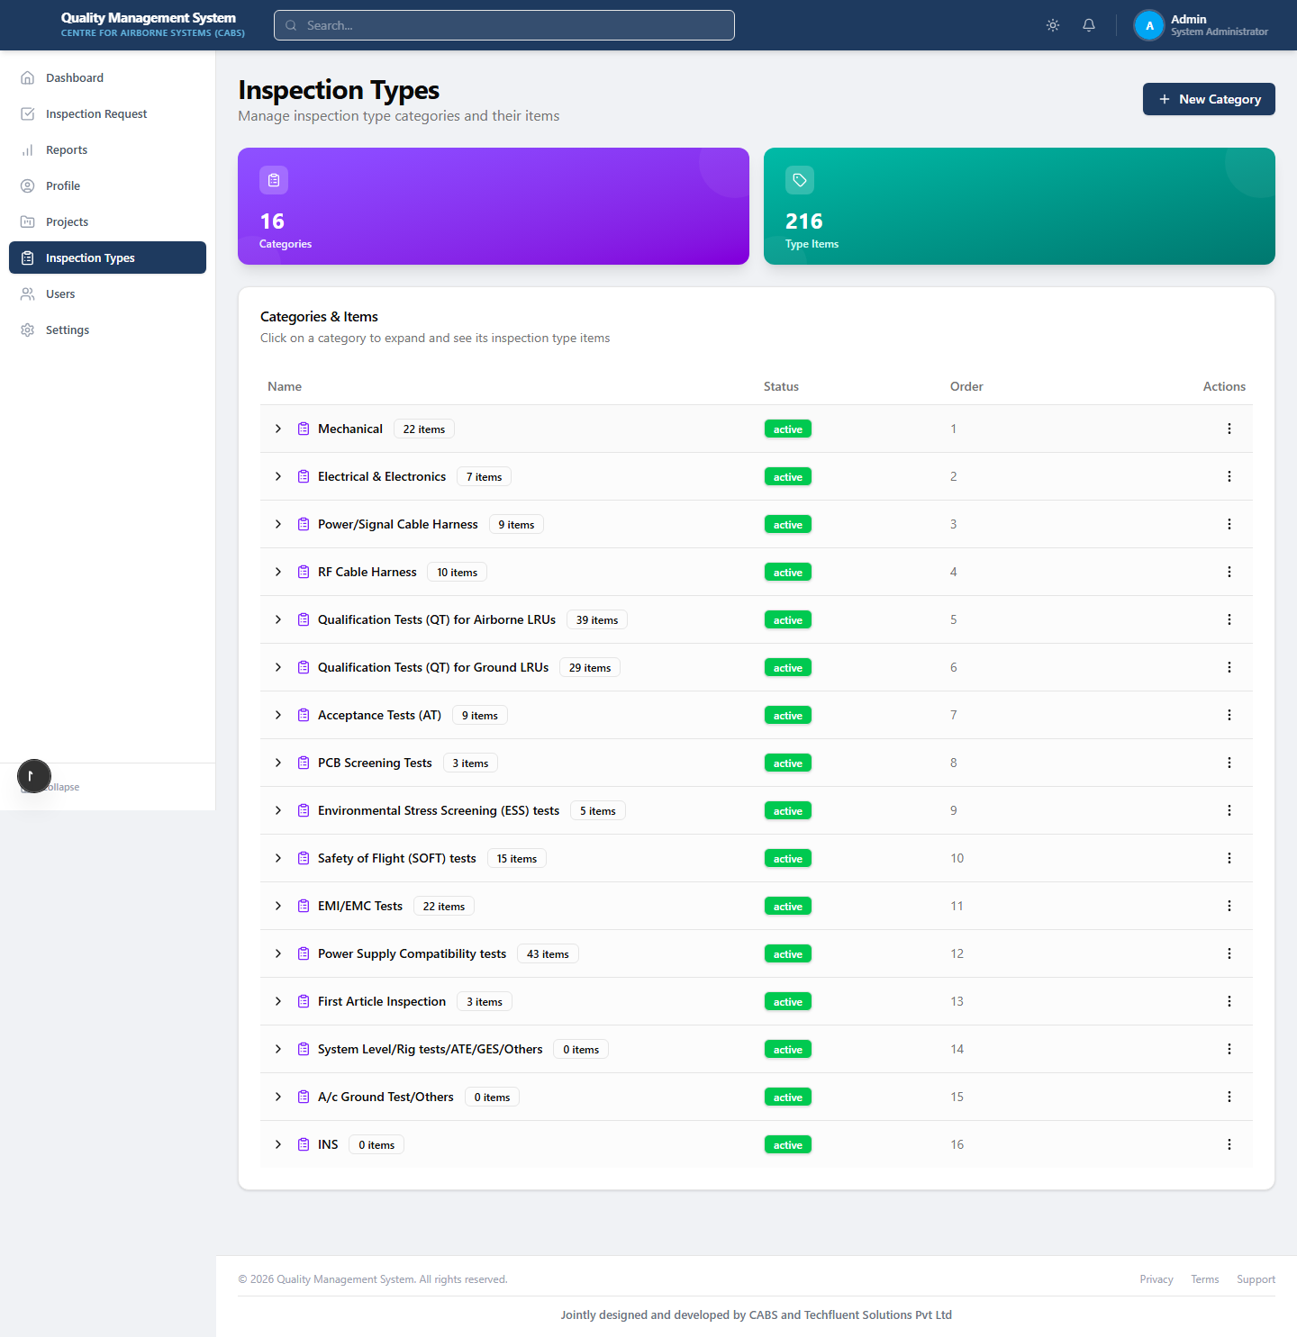
Inspection Types & Checklists

Slide 14
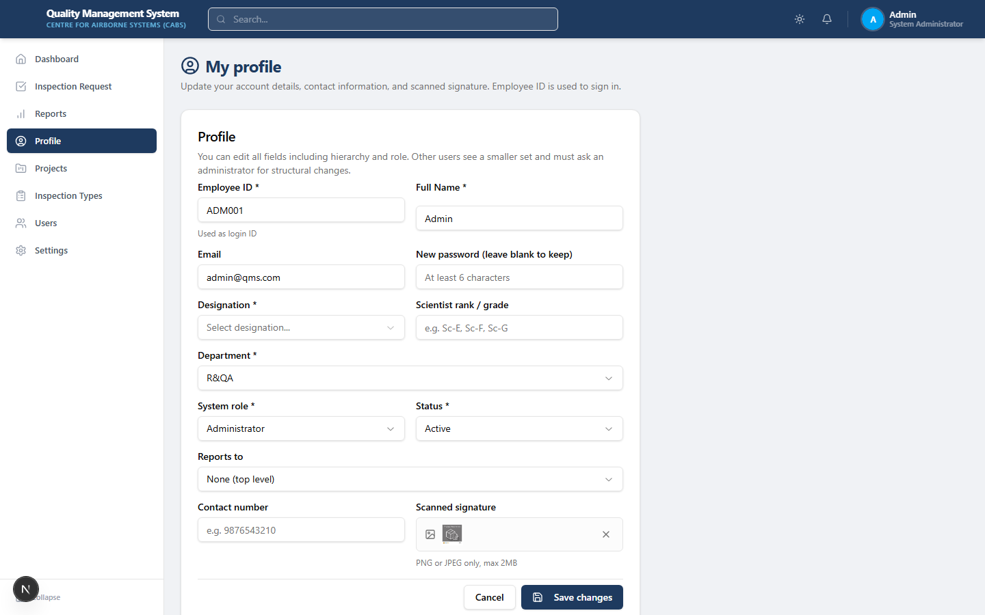
Profile & Password

Slide 15


